Slide 1
Linear Discriminant Analysis
Chapter 4.4

Slide 2
Reminder of Classification
Classification methods seek to classify a categorical outcome into one of two or more categories based on various data attributes.
Consider a set of observations x (also called features, attributes, variables, or measurements) for each sample of an object or event with known class y∈{0,1}. This set of samples is called the training set. The classification problem is then to find a good predictor for the class y of any sample of the same distribution (not necessarily from the training set) given only an observation x.
For a given set of predictor variables, we would like to assign the best value of the categorical variable.
For each record in a database, we have a categorical variable of interest and a number of additional predictor variables.

Slide 3
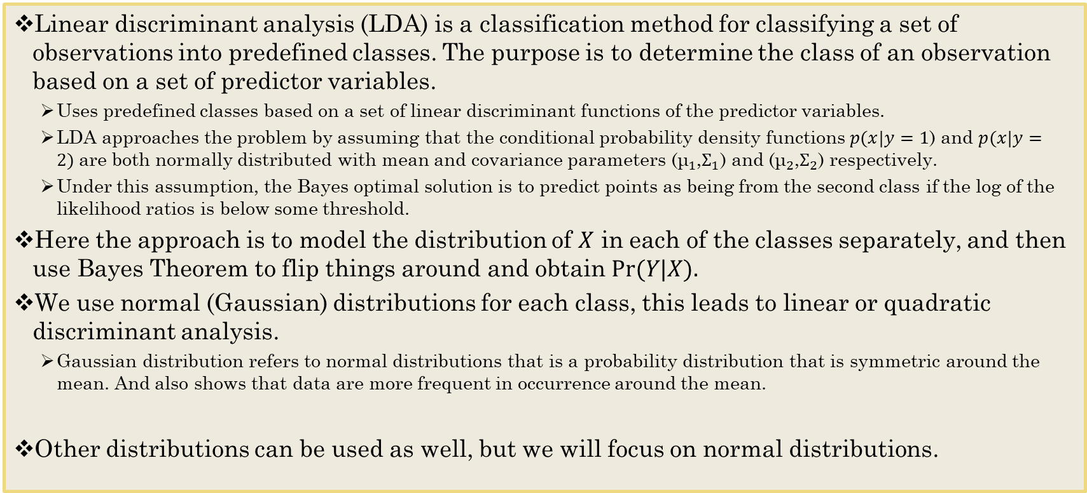
Discriminant Analysis
Linear discriminant analysis (LDA) is a classification method for classifying a set of observations into predefined classes. The purpose is to determine the class of an observation based on a set of predictor variables.
Uses predefined classes based on a set of linear discriminant functions of the predictor variables.
LDA approaches the problem by assuming that the conditional probability density functions $p(x|y=1$) and $p(x|y=2)$are both normally distributed with mean and covariance parameters (${\text{μ}}_{1}$,$Σ_{1}$) and (${\text{μ}}_{2}$,$Σ_{2}$) respectively.
Under this assumption, the Bayes optimal solution is to predict points as being from the second class if the log of the likelihood ratios is below some threshold.
Here the approach is to model the distribution of $X$ in each of the classes separately, and then use Bayes Theorem to flip things around and obtain $Pr⁡(Y|X).$
We use normal (Gaussian) distributions for each class, this leads to linear or quadratic discriminant analysis.
Gaussian distribution refers to normal distributions that is a probability distribution that is symmetric around the mean. And also shows that data are more frequent in occurrence around the mean.
Other distributions can be used as well, but we will focus on normal distributions.

Slide 4
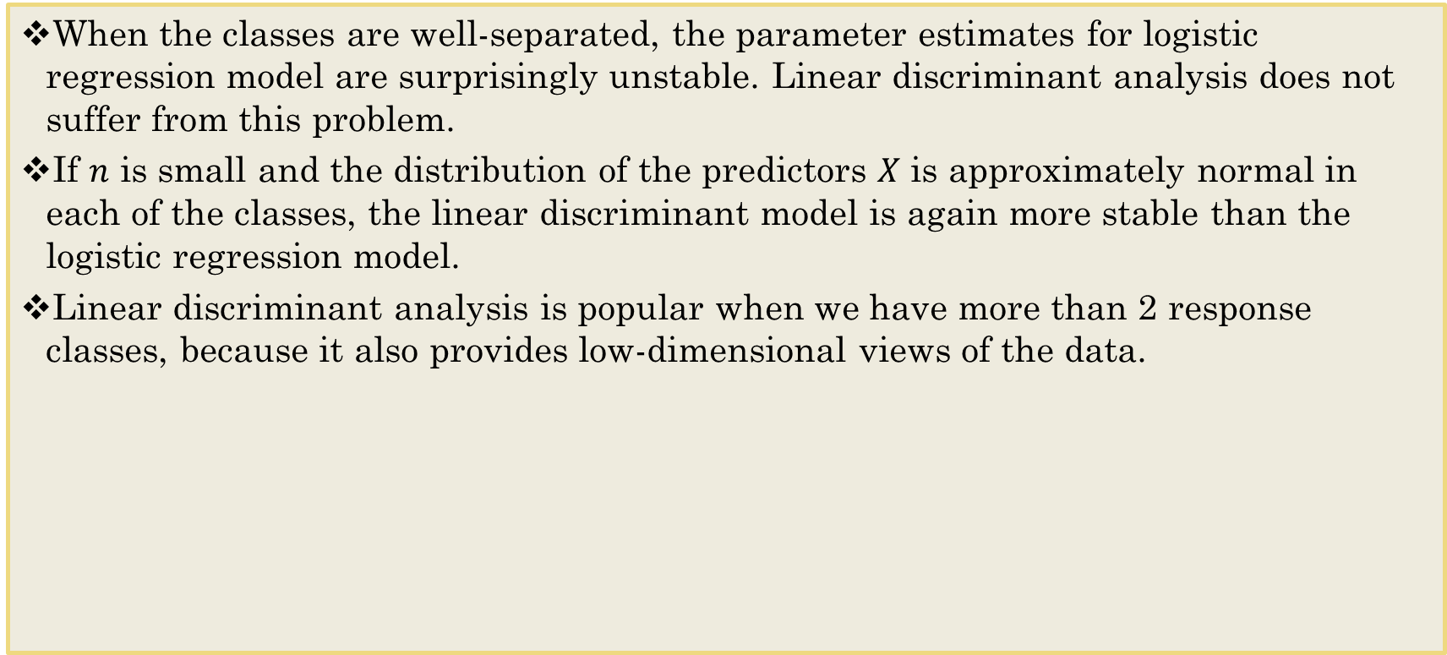
Why discriminant analysis?
When the classes are well-separated, the parameter estimates for logistic regression model are surprisingly unstable. Linear discriminant analysis does not suffer from this problem.
If $n$ is small and the distribution of the predictors $X$ is approximately normal in each of the classes, the linear discriminant model is again more stable than the logistic regression model.
Linear discriminant analysis is popular when we have more than 2 response classes, because it also provides low-dimensional views of the data.

Slide 5
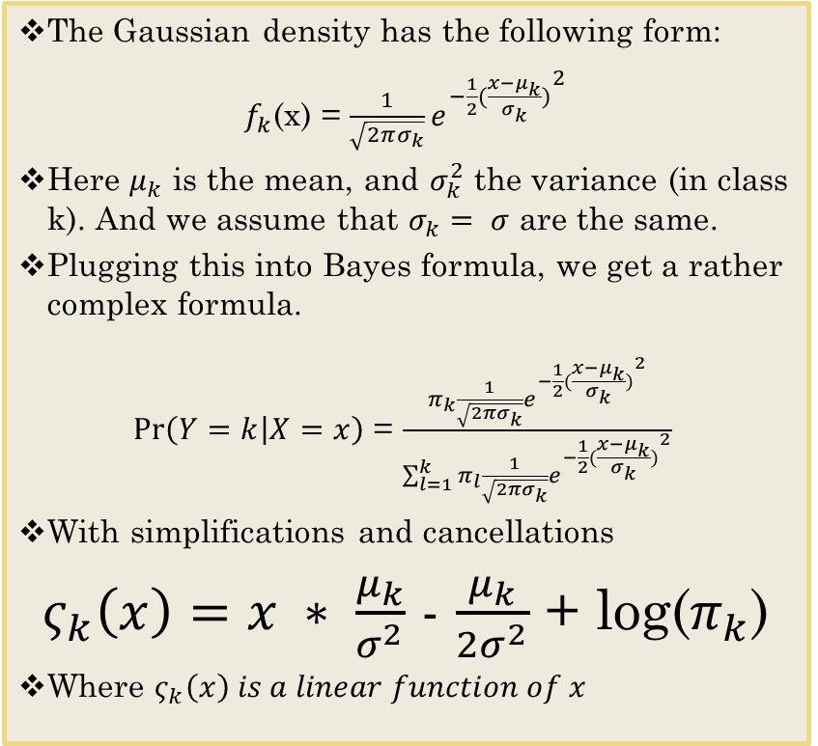
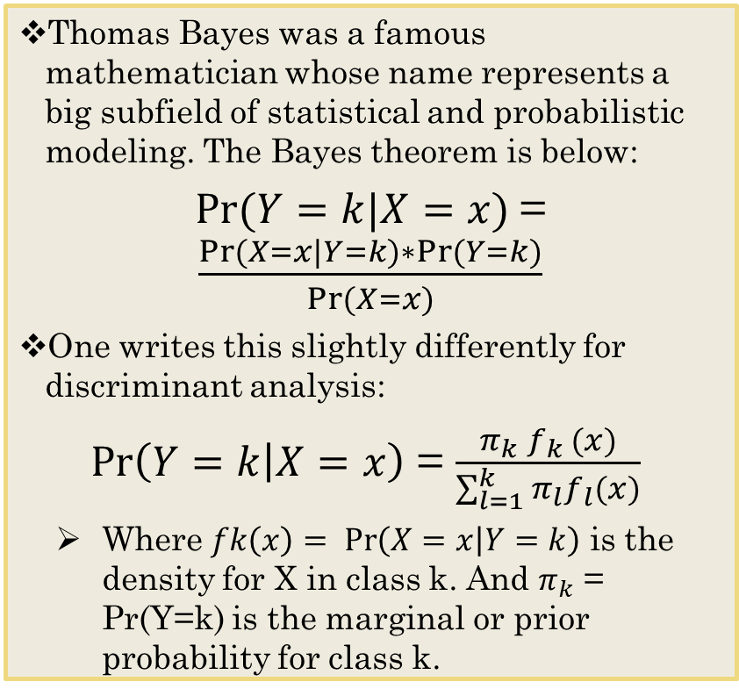
Bayes theorem for classification
Thomas Bayes was a famous mathematician whose name represents a big subfield of statistical and probabilistic modeling. The Bayes theorem is below:
$Pr⁡(Y=k|X=x)$= $\frac{Pr⁡(X=x|Y=k)∗Pr⁡(Y=k)}{Pr⁡(X=x)}$
One writes this slightly differently for discriminant analysis:
$\operatorname{Pr}\left(Y=k | X=x\right)$ = $\frac{π_{k}⁡f_{k} (x)}{\sum_{l=1}^{k}{π_{l}f_{l}(x)}}$
Where $fk\left(x\right)= \operatorname{Pr}\left(X=x | Y=k\right)$ is the density for X in class k. And $π_{k}$ = Pr(Y=k) is the marginal or prior probability for class k.
The Gaussian density has the following form:
$f_{k}$(x) = ${\frac{1}{\sqrt{2πσ_{k}}}e^{−\frac{1}{2}(\frac{x−μ_{k}}{σ_{k}})}}^{2}$
Here $μ_{k}$ is the mean, and $σ_{k}^{2}$ the variance (in class k). And we assume that $σ_{k}= σ$ are the same.
Plugging this into Bayes formula, we get a rather complex formula.
$\operatorname{Pr}\left(Y=k | X=x\right)$ = $\frac{π_{k}⁡{\frac{1}{\sqrt{2πσ_{k}}}e^{−\frac{1}{2}(\frac{x−μ_{k}}{σ_{k}})}}^{2}}{\sum_{l=1}^{k}{π_{l}{\frac{1}{\sqrt{2πσ_{k}}}e^{−\frac{1}{2}(\frac{x−μ_{k}}{σ_{k}})}}^{2}}}$
With simplifications and cancellations
$ς_{k}\left(x\right)=x ∗ \frac{μ_{k}}{σ^{2}}$ - $\frac{μ_{k}}{{2σ}^{2}}$ + log($π_{k}$)
Where $ς_{k}\left(x\right) is a linear function of x$

Slide 6
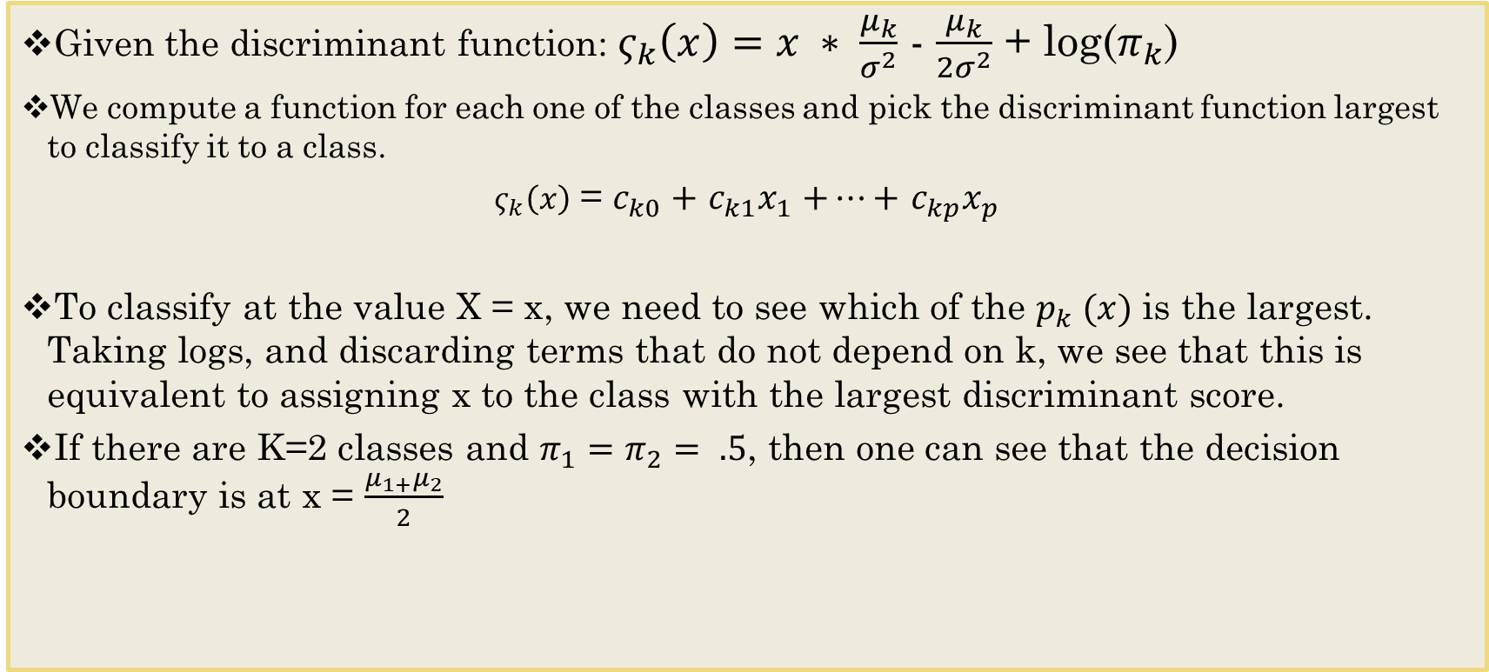
Linear Discriminant Function
Given the discriminant function:${ ς}_{k}\left(x\right)=x ∗ \frac{μ_{k}}{σ^{2}}$ - $\frac{μ_{k}}{{2σ}^{2}}$ + log($π_{k}$)
We compute a function for each one of the classes and pick the discriminant function largest to classify it to a class.
$ς_{k}\left(x\right)$ = $c_{k0}+$ $c_{k1}x_{1}$ $+…+$ $c_{kp}x_{p}$
To classify at the value X = x, we need to see which of the $p_{k} (x)$ is the largest. Taking logs, and discarding terms that do not depend on k, we see that this is equivalent to assigning x to the class with the largest discriminant score.
If there are K=2 classes and $π_{1}=π_{2}= .5$, then one can see that the decision boundary is at x = $\frac{μ_{1+}μ_{2}}{2}$

Slide 7
Data Structure
Missing values
If missing values are found in any of the independent variables being used, the row is omitted. If they occur only in the dependent (categorical) variable, the row is not used during the calculation of the prediction equations, but a predicted group, and associated scores, are calculated. This allows you to classify new observations.
Sample size is important
You should have more observations per group than you have predictor variables.
Unequal group size is not uncommon but can cause subtle changes during the classification phase.
Categorical dependent variable
Each unique value represents a separate group. The values may be text or numeric.
Independent predictor variables can be continuous or categorical

Slide 8
Assumptions
No strongly influential outliers
Multivariate normality
Multicollinearity
Homoscedasticity
Independence
LDA is not necessarily bad when the assumptions about the density functions are violated. However, in certain cases, LDA may yield poor results

Slide 9
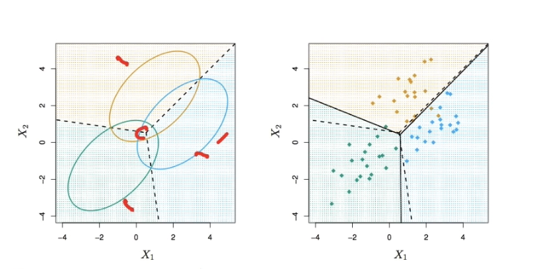
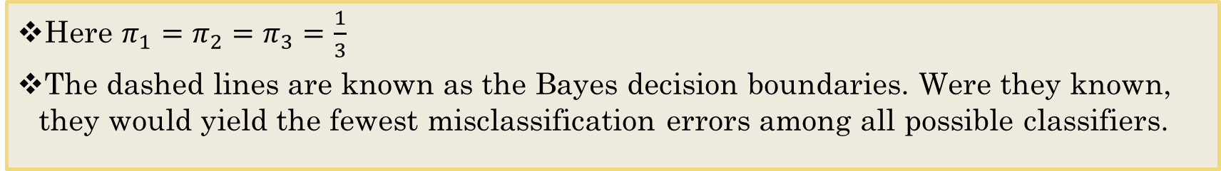
Here p=2, k=3
Here $π_{1}=π_{2}=π_{3}=\frac{1}{3}$
The dashed lines are known as the Bayes decision boundaries. Were they known, they would yield the fewest misclassification errors among all possible classifiers.

Slide 10
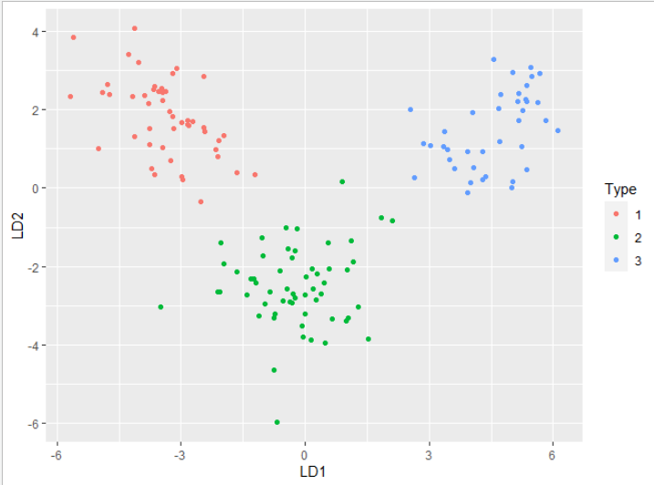
Fisher’s Discriminant Plot
LD is the Linear Discriminant Variable
When there are K classes, linear discriminant analysis can be viewed exactly in a K-1 dimensional plot, because it essentially classifies to the closest centroid, and they span a K-1 dimensional plane.
LD1 is a linear function that achieves the maximum separation of our three groups. LD2 is a linear function, orthogonal to LD1, that achieves the maximal separation among all linear functions orthogonal to LD1, etc.
Notes:
LD2 has to be orthogonal to LD1 – in order to achieve maximal separation

Slide 11
Summary
Linear discriminant analysis for prediction in p dimensions can be transformed to a much simpler rule in K−1 dimensions, where K is the number of classes.
This transformation was achieved by first sphering the data points, and then projecting based on these sphered class centroids. The final prediction rule is basically nearest centroid classification, except for the factor adjusting for different class proportions.
Further transformations, to dimensions L < K−1, can also be performed; this is called reduced-rank linear discriminant analysis.
If the number of classes K is large, then projecting down to a dimension L < K−1 can be helpful in terms of applying regularization. This is because some dimensions may not provide a lot of separation between the classes, but just noise.
Pointing to the bias-variance tradeoff!

